Slide 1

Image Retrieval
By: Yanelly Hernandez
By: Yanelly

Slide 2
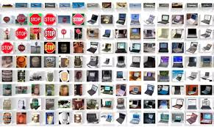
Intro
DataSet: caltech101
101 classes
40-80 images per class
Goal: Aim above 80% of f1 score at k and above 90% top accuracy at k.
Notes:
F1 score k = 1
Top accuracy k=5

Slide 3
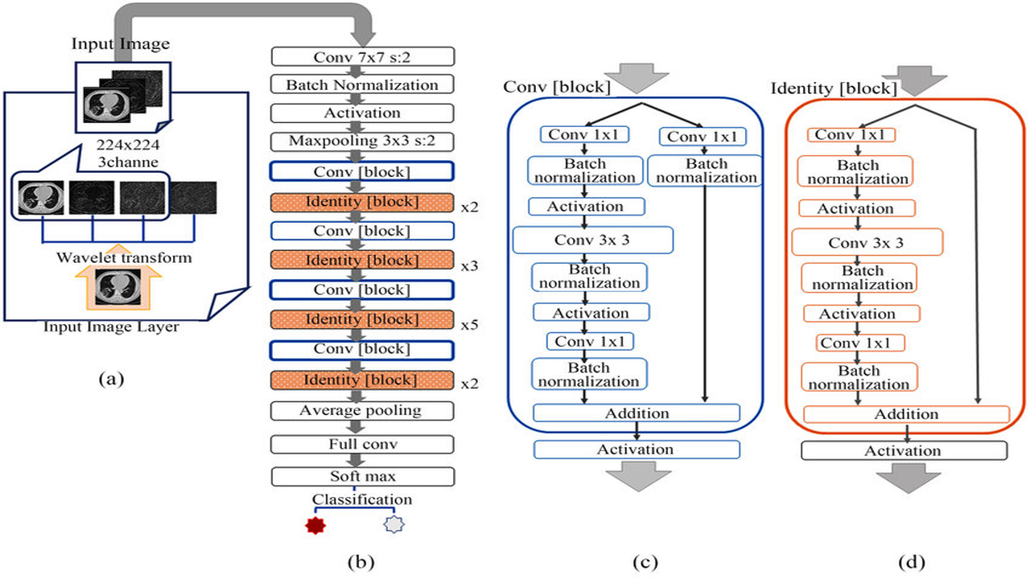
Chosen Model
Resnet50

Slide 4
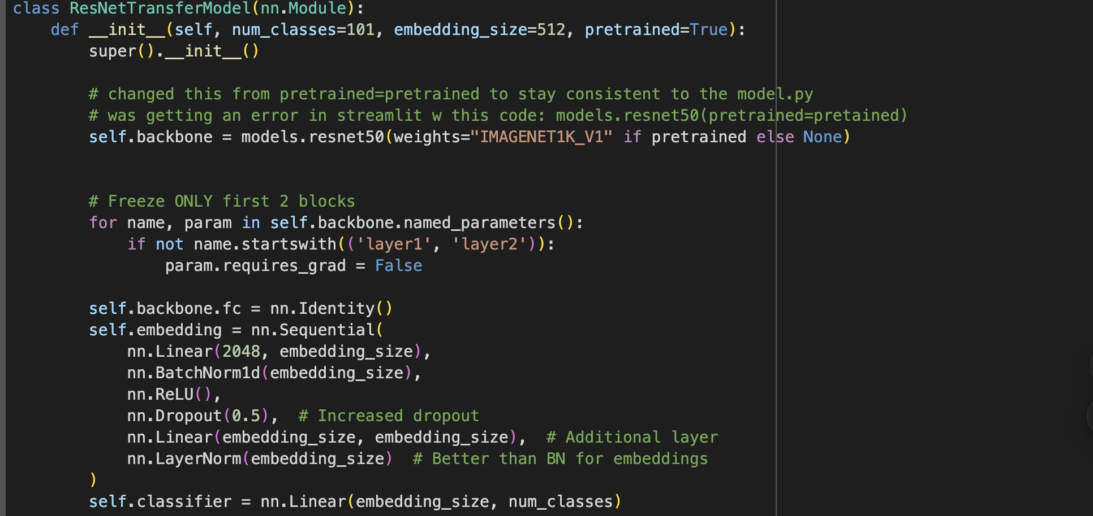
Chosen Model cont:
512: Embedding size
Freezing first 3 layers
Relu: Activation function
Notes:
I chose an embedding size of 512 instead of 256 to allow the model to capture more detailed and expressive features for each image, which is especially useful for tasks like image retrieval.
I froze the early layers of the ResNet-50 backbone because they capture generic low-level features like edges and textures. Freezing them helps reduce overfitting and speeds up training.
I am using relu as the activation function

Slide 5
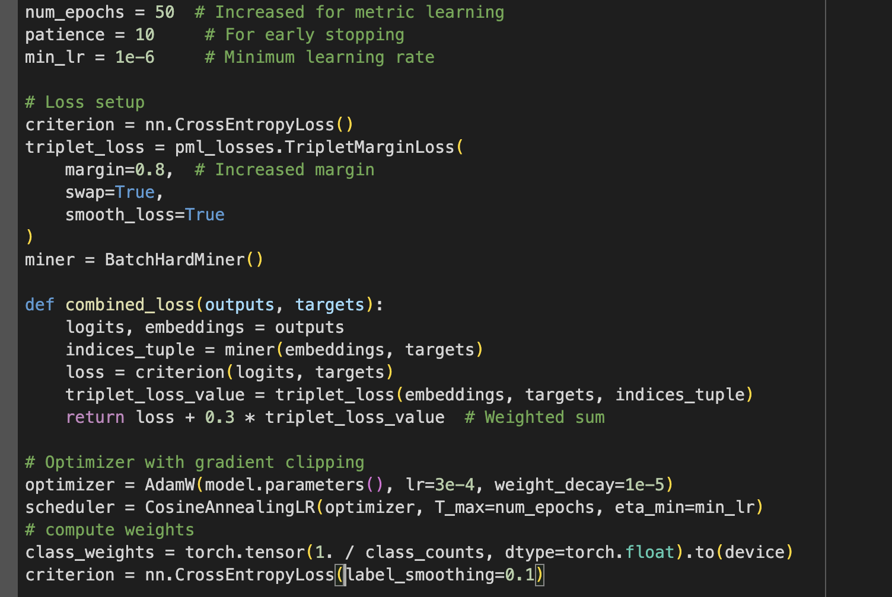
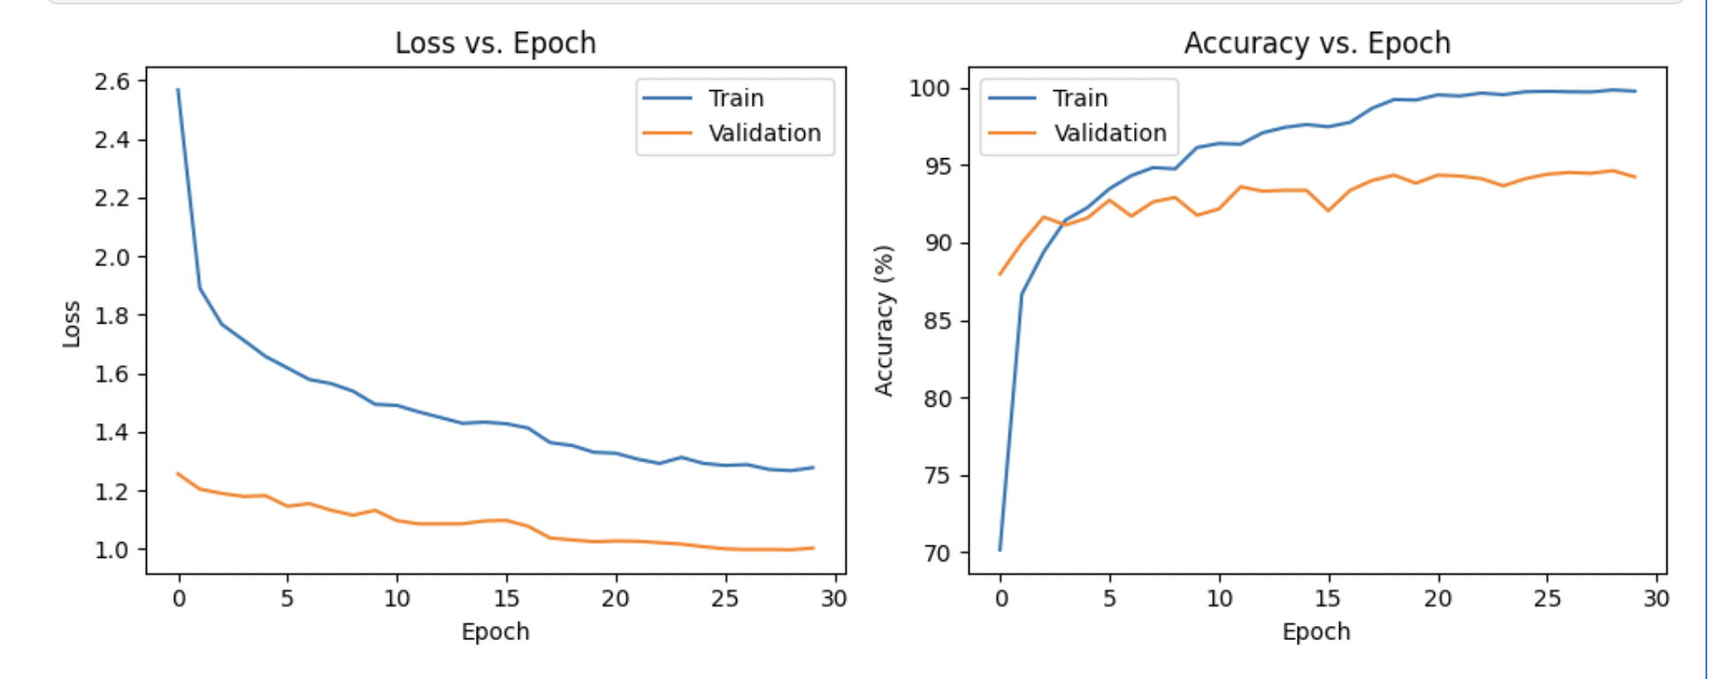
Why the Chosen Model
Better accuracy
Not overfitting or underfitting
Notes:
When selecting my model, I aimed to minimize overfitting. I initially experimented with ResNet34 but noticed signs of overfitting, especially without early stopping. I then tried ResNet18, which helped with overfitting but struggled with accuracy. Finally, I chose ResNet50, which offers better accuracy and generalization. To further prevent overfitting, I incorporated early stopping in training.

Slide 6
Results + Evaluation
Mean Average Precision (mAP) = 92.53%
Mean Reciprocal Rank (MRR) = 94.53%
Precision@k = 93.61%
Recall@k = 93.61%
F1 Score@k= 93.61%
Top k accuracy= 95.85%

Slide 7
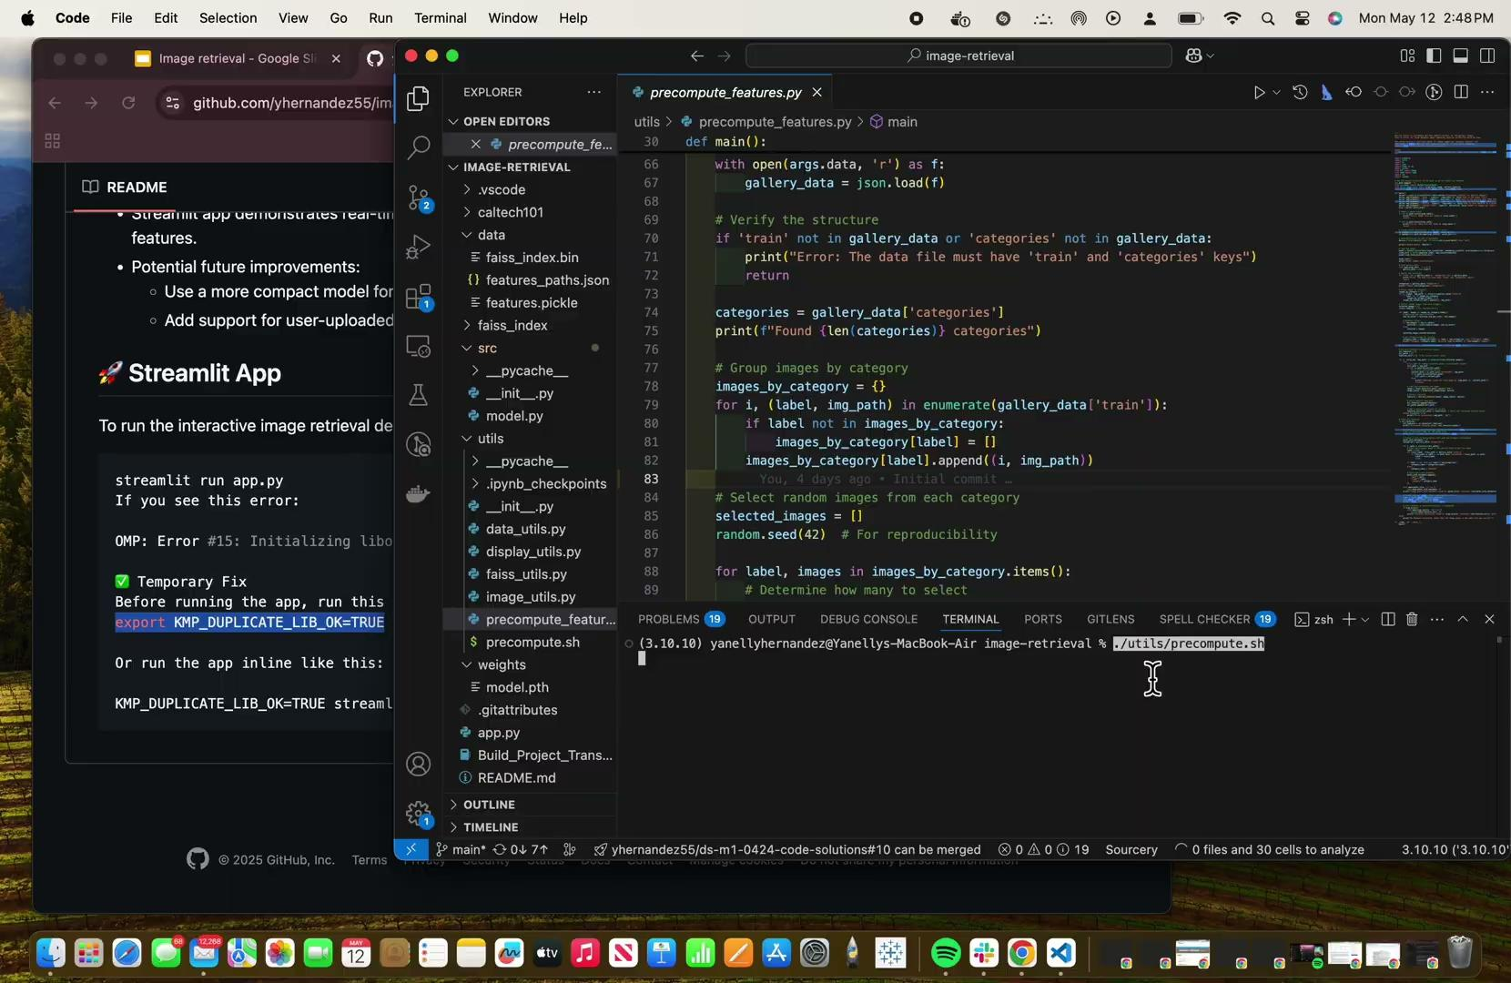
Demo

Slide 8
Conclusion
Top k accuracy score at k=5
F1 score at k=1

Slide 9
Sources
https://blog.roboflow.com/what-is-resnet-50/#:~:text=ResNet%2D50%20is%20a%20convolutional,it%2C%20and%20categorize%20them%20accordingly.
https://www.tensorflow.org/datasets/catalog/caltech101
https://www.restack.io/p/transfer-learning-answer-layer-freezing-cat-ai
https://medium.com/@danushidk507/embeddings-techniques-52fab649d033#:~:text=The%20dimensionality%20of%20the%20embeddings,details%20and%20maintaining%20operational%20efficiency
https://www.v7labs.com/blog/neural-networks-activation-functions

Slide 10
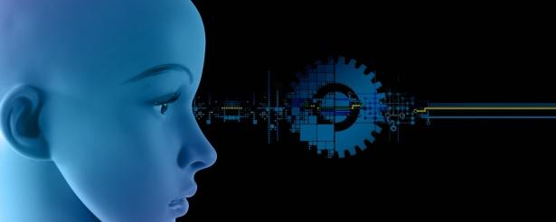
Thank You

